Slide 1
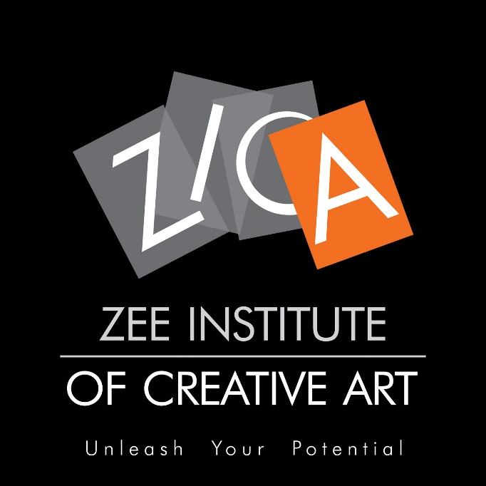
PRODUCT PRESENTATION

Slide 2
Essel Group is among India’s most prominent business houses with a diverse portfolio of assets in media, packaging, entertainment, technology-enabled services, infrastructure development and education.
The Group started business in 1926 with a commodity trading and export firm, Rama Associates Limited, and has since then metamorphosed into a conglomerate that is a symbol of the ingenuity and power of Indian entrepreneurship, with worldwide operations and a workforce of nearly 10,000 dedicated employees.

Slide 3
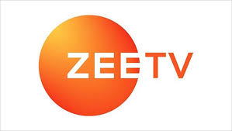
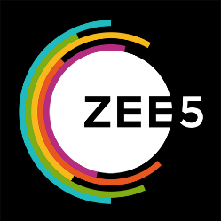
Zee5
It is a video on demand website run by Zee Entertainment Enterprises Limited (ZEEL).

Slide 5
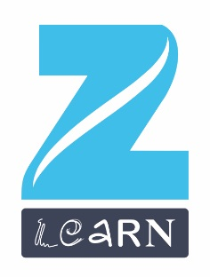
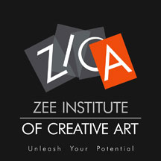
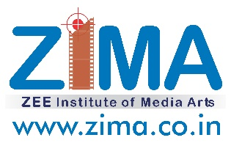
Backed by Zee and Essel Group, Zee Learn aims to empower India’s children and youth
Asia’s largest preschool
2000+ centers
700+ cities
7+ lakh children
India’s fastest growing network
- over 150 schools
- across 110+ cities
An IB school of global standards at BKC Mumbai
VOCATIONAL TRAINING
ZICA is the India’s first full-fledged 2D, 3D Animation, VFX, Gaming, Graphic & Web Training Academy with 22 centers across India
Courses in Film Making, Television, Music, Radio, Journalism with 2 centers in Mumbai & Jaipur

Slide 6
WHY ZICA
2018-2023
TOP GROWTH SECTORS
PIONEER IN ANIMATION EDUCATION
ALL INDIA BRAND PRESENCE
DIVISION OF M&E CONGLOMERATE

Slide 7
A division of Zee network education group
Industry standard programs
India’s first classical & digital animation academy, since 1995
WHY ZICA?
22 centers across India in major cities including Mumbai, Jaipur, Indore, Ranchi, Bhubaneswar, Guwahati, Nagpur, Nashik, Coimbatore etc.
Alumni being stalwarts in the industry
State of the art facilities and infrastructure
A well laid centralized assessment process
An active placement cell to provide employment assistance

Slide 8
ZICA NURTURES
ANALYTICAL SKILLS & CREATIVE SKILLS
Design
Visualization
Communication
Concept Building
Storytelling
Forecasting
Problem Solving
Painting
Photographic /
Cinematographic
Troubleshooting
Research
Acting
Drawing
Brainstorming
Script Writing

Slide 9
STUDENT CENTRIC TRAINING METHODOLOGY
Faculty Led Learning
Classroom learning
Practice Lab
Assignment based skill development
Group Learning
Group Projects
Master Classes
Group Discussions
Learning through Activities
National Student meet
Work review & Feedback
Portfolio Development
Self Driven Learning
Course Revision
Library Reference
Research & Development
Project Work
E-STUDIO
ZICA APP
Faculty Led Learning
Group Learning
Self Driven Learning

Slide 10
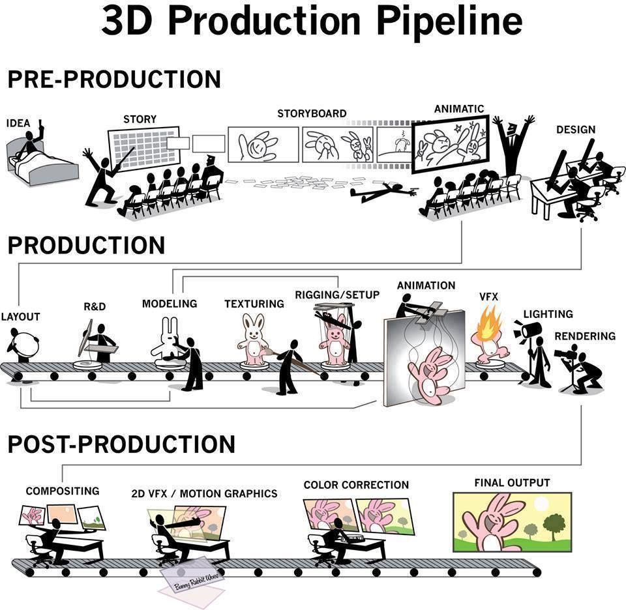
CAREER PROGRAM FLOW
ZICA Career Programs takes the student through the Production Pipeline of Animation Film Making process

Slide 11
SELF-STUDY
2018-2023
TOP GROWTH SECTORS
PRE-PRODUCTION
PRODUCTION
POST PRODUCTION

Slide 12
PRE-PRODUCTION
Pre-production is the planning phase of a film project and where the foundation is developed and refined. The more time you spend getting this part of the process correct, the more likely your film will be successful. Work performed in pre-production is used to create film content, but pre-production assets don’t go into the film.
During pre-production, you take an idea or concept for a short film and develop it into a story. The story is transformed visually into a format where details and story flow can be refined. Finally, drawings are created to define the characters, environments, and overall look of the film.
Pre-production is critical because it allows you to plan, add, remove, or change elements of your film so it works from the start. It creates a solid foundation for your project before you create any assets or begin production work.

Slide 13
PRODUCTION
Now that the storyboard has been approved the project enters the production phase. It’s here that the actual work can start, based on the guidelines established during preproduction. Some major parts are layout, modeling, texturing, lighting, rigging and animation. Following is the process
Review and refine the script of your commercial or spot to match visuals to the story that what you want to tell.
Take your drawing and create a 3D model of the character based on that 2D design.
Rig the 3D character model, essentially creating a movable skeleton to drive the motion of the character.
Create and review storyboard for the animation. Refine as needed.
Record any dialog for the character or narration for the spot.
Create an animatic video, either storyboard panels set to the audio or very rough 3D animation. Review and refine as needed.
Create a rough animation of the character for review. This would be a low-quality image representation to make sure timing and posing and movement is correct.
Refine animation based on reviews and feedback of the rough cut.
High-quality rendering of the animation footage.
Edit, composite, and grade animation footage, adding in special effects and titles.

Slide 14
POST-PRODUCTION
Post-production is the third and final step in film creation, and it refers to the tasks that must be completed or executed after the filming or shooting ends. These include the editing of raw footage to cut scenes together, inserting transitional effects, working with voice and sound actors and dubbing to name just a few of the many post-production tasks. Overall, however, the three main phases of post-production are
Compositing
Sound editing
Video editing.

Slide 15
2D animation
2D Topics | Descriptions | YouTube Links
Animation Introduction | The technique of photographing successive drawings or positions of models or puppets to create an illusion of movement when the film is shown as a sequence. | https://www.youtube.com/watch?v=NZbrdCAsYqU
Sketching | A sketch is a rapidly executed freehand drawing that is not usually intended as a finished work. | https://www.youtube.com/watch?v=CqeuQF1qpvQ
Human Figure Study | A figure drawing is a drawing of the human form in any of its various shapes and postures using any of the drawing media. | https://www.youtube.com/watch?v=GzaJS-udeDk
Animal Study | A figure study is a drawing or painting of the animal body made in preparation for a more composed or finished work. | https://www.youtube.com/watch?v=7e5cWMA6kbw
Perspective Study | Perspective in the graphic arts is an approximate representation, generally on a flat surface (such as paper), of an image as it is seen by the eye. | https://www.youtube.com/watch?v=_l1NueQGOqQ
Colour Theory | In the visual arts, colour theory is a body of practical guidance to color mixing and the visual effects of a specific color combination. | https://www.youtube.com/watch?v=L1CK9bE3H_s
Story | A story is a depiction of a journey. In a story we follow a character or a series of characters on a journey as they pursue something up against certain obstacles. | https://www.youtube.com/watch?v=W0HEqI3pJIM
Layout Design | In traditional animation, a background layout is the line drawing of the background for a scene. | https://www.youtube.com/watch?v=3tqedKuKDxw

Slide 16
2D animation
2D Topics | Descriptions | YouTube Links
Character Design | Character design may refer to: Characterization, the process of conveying information about characters | https://www.youtube.com/watch?v=51YeZCqbpHg
Digital Illustration | Digital illustration is the use of digital tools to produce images under the direct manipulation of the artist, usually through a pointing device such as a tablet or a mouse. | https://www.youtube.com/watch?v=B3ZeW76sezY
Storyboard | A sequence of drawings, typically with some directions and dialogue, representing the shots planned for a film or television production. | https://www.youtube.com/watch?v=bMX65SveVuI
Computer Graphics - BG Paint | Digitally painted ground or parts of a scene, situated in the rear of any animated character. | https://www.youtube.com/watch?v=bkX8OZ-_QUM
Animatic | a preliminary version of a film, produced by shooting successive sections of a storyboard and adding a soundtrack. | https://www.youtube.com/watch?v=3sE5ox9kkUg
Digital 2D Animation | 2D animation creates movement in a two-dimensional artistic space. Work in the field of 2D animation requires both creativity and technological skills. | https://www.youtube.com/watch?v=R02q52zrEBs
Stopmotion | Stop Motion Animation is a technique used in animation to bring static objects to life on screen. This is done by moving the object in increments while filming a frame per increment. When all the frames are played in sequence it shows movement. | https://www.youtube.com/watch?v=wVjMFU11hVA
Audio Editing | Audio editing is the process of manipulating audio to alter length, speed, and volume or to create additional versions such as loops. | https://www.youtube.com/watch?v=fknmkG0mPzw
Video Editing | Video editing is the process of manipulating and rearranging video shots to create a new work. It involves titling, colour correction, sound mixing, etc. | https://www.youtube.com/watch?v=d3V3XN3wrqA

Slide 17
2D SOFTWARE
Adobe Photoshop | https://www.youtube.com/watch?v=VseIS2-YAi0
Adobe Illustrator | https://www.youtube.com/watch?v=yCyE91-D-KI
Adobe Animate | https://www.youtube.com/watch?v=txCssT1iRL4
Adobe Premiere | https://www.youtube.com/watch?v=UbAjaCfs6W8
Adobe Audition | https://www.youtube.com/watch?v=3WoMCeYBghw

Slide 18
3D animation
3D Topics | Descriptions | YouTube Links
Architectural Animation | It provides visualization of a prospective building in a 3D environment | https://www.youtube.com/watch?v=KzLJVFIZXYk
Product designing | Product design consists in imagining and creating objects meant for mass production. The definition encompasses the physical aspects as well as the functionalities products should possess. | https://www.youtube.com/watch?v=RD0eXeRjeFk
In-organic Modelling / Asset Development | Inorganic modeling includes all those things that are sharp and have some hard surface in nature. Like Tables, Chairs, Crates etc. | https://www.youtube.com/watch?v=kLwKHcJPFdQ
Organic Modelling | Organic modeling includes all those real world things and stuffs that are curvy and dynamic in nature. Like Human beings, Terrains, Plants and trees etc. | https://www.youtube.com/watch?v=q3qbVFLkWyE
Texturing | A texture map is a two-dimensional image file that can be applied to the surface of a 3D model to add color, texture, or other surface detail like glossiness, reflectivity, or transparency. | https://www.youtube.com/watch?v=-fYX_VS5jCE
Lighting | Lighting or illumination is the deliberate use of light to achieve a practical or aesthetic effect. There are six standard lighting options in 3D, they are Omni Light, Directional Light, Spot Light, Area Light, Volume Light, Ambient Light. | https://www.youtube.com/watch?v=CNn_qWAEZX8

Slide 19
3D animation
3D Topics | Descriptions | YouTube Links
Rigging | 3D rigging is the process of creating a skeleton for a 3D model so it can move. Most commonly, characters are rigged before they are animated. | https://www.youtube.com/watch?v=-pZ71n23uGE
Animation | It is the manipulation of 3D models or objects is carried out within 3D software for exporting picture sequences giving them the illusion of animation or movement. | https://www.youtube.com/watch?v=SujizPOE7rM
Sculpting | 3D sculpting (also called digital sculpting) is when an artist sculpts a 3D object on a computer with material similar to digitized clay. Software with brushes and tools that push, pull, pinch and smooth make it easy to create detailed sculpts that mimic real life textures and objects. | https://www.youtube.com/watch?v=3d9rJVi1V78
Rendering | 3D rendering is the 3D computer graphics process of automatically converting 3D wire frame models into 2D images on a computer. 3D renders may include photorealistic effects or non-photorealistic rendering. | https://www.youtube.com/watch?v=IFfloMczaz0

Slide 20
3D SOFTWARE
Autodesk Maya | https://www.youtube.com/watch?v=NroCnPy1gpo
Substance Painter | https://www.youtube.com/watch?v=ZwotHwt-YWk
Autodesk Arnold | https://www.youtube.com/watch?v=0MJ9lbKF2-U
Pixologic Z-Brush | https://www.youtube.com/watch?v=4HkH3xrJ7Xs
V-Ray | https://www.youtube.com/watch?v=DUlH5-JpFH0
Motion Builder | https://www.youtube.com/watch?v=65GBG47SxZg

Slide 21
Visual effects
VFX Topics | Descriptions | YouTube Links
Maya Motion | Maya software now has a fully integrated 3D motion graphics toolset. Based on the MASH plugin, the new 3D motion graphics toolset in Maya makes it easy and fun for motion graphic designers and artists to create 3D motion graphics. | https://www.youtube.com/watch?v=YLzOScJ0fJ4
Particles - Dynamics | A particle system is the engine that drives effects like smoke, rain, fire, and other phenomena that require a large number of small moving objects. | https://www.youtube.com/watch?v=0nxR3Ri3ucI
Technical Animation | It is otherwise called CHF (Cloth, Hair & Fur) animation | https://www.youtube.com/watch?v=wL6vCMqc9UA
Liquid Simulation | Fluid animation refers to CG techniques for generating realistic animations of fluids such as water and smoke. | https://www.youtube.com/watch?v=rn5l36TUccE
Motion Graphics | Motion graphics are pieces of digital footage or animation which create the illusion of motion or rotation, and are usually combined with audio for use in multimedia projects. | https://www.youtube.com/watch?v=E5L7P9jQhNo
Compositing | Compositing is the combination of multiple layers of images or video elements to render a final still or moving image. | https://www.youtube.com/watch?v=gYu4esqvnQ0
Masking | Masking is a technique that hides parts of a scene as if they were behind an invisible object. It can be used to create environments that extend behind, and are framed by, a target image. | https://www.youtube.com/watch?v=OzAkb7Cw0uM
Rotoscope | Rotoscoping is an animation technique that animators use to trace over motion picture footage, frame by frame, to produce realistic action. | https://www.youtube.com/watch?v=nDaEKy7qB7U

Slide 22
Visual effects
VFX Topics | Descriptions | YouTube Links
Colour Correction | Color correction is the manipulation of the saturation, luminance and balance of the red, green and blue values of your recorded image. | https://www.youtube.com/watch?v=_YRHy88En04
Compose render passes | Each render pass contain different information in the image such as, diffuse, specular, reflection, motion, Z-depth. These passes (separate images) can be combined together to produce a final beauty pass within a compositor. | https://www.youtube.com/watch?v=jBO7ywXpxCY
Keying | Keying is when a special compositing effect, that happens when you take a part of a video and make it transparent. This part of the video is chosen based on color, luminance, or even a mask. | https://www.youtube.com/watch?v=M806ew1JR_c
Tracking | Tracking is the process of automatically locating a point or series of points from frame to frame in a sequence, allowing the user to stabilise, track to or solve object or camera movement in the shot. | https://www.youtube.com/watch?v=0L34HsXXU00
Paint / Clean-up | VFX paint is the process of removing tracking markers after the creation of masks around characters and objects. | https://www.youtube.com/watch?v=eP0YkW5ed8c&t=31s
Wire / Rig Removal | Wire removal is a VFX technique used to remove wires in films, where the wires are originally included as a safety precaution or to simulate flying in actors or miniatures. | https://www.youtube.com/watch?v=UiW5Nvi0nls
Camera Projection | It can transform a 2D matte painting into a 3D scene, complete with a moving camera and shifting perspective. | https://www.youtube.com/watch?v=zS7TheOr9oU
Camera tracking | Camera Tracking is a process which involves taking a post that has been filmed with a real live camera and tracking it's motion so that 3d elements can be added to it. | https://www.youtube.com/watch?v=kzym73lhmD4

Slide 23
Visual effects
VFX Topics | Descriptions | YouTube Links
Relighting | Majorly lighting is done in CG or 3D environment. We can relight any scene by using compositing software if there is minor changes in lighting to be done before rendering. | https://www.youtube.com/watch?v=VpQr5XUeoSg
Stereo conversion | Stereo conversion, or dimensionalization as it is sometimes called, is the process of making stereo (3D) images from non-stereo traditional 2D images. | https://www.youtube.com/watch?v=5UADSoEFo6c
Motion blur roto | Rotoscopy is drawing shapes to extract, isolate or affect a portion of an image. Fast moving objects create motion blur, which is very tricky to roto. | https://www.youtube.com/watch?v=5zsFv24Sm0Y
Roto using IK | Roto by using IK (Inverse Kinematics) for animating humans, animals and all manner of jointed creatures | https://www.youtube.com/watch?v=8UgcG2-D1Ak
Set Extension | This allows film makers to create an illusion of an environment or an extension of the set that may be expensive to build or impossible to visit. | https://www.youtube.com/watch?v=wguOk1HnTbA
Visual Effects | Visual effects are the processes by which imagery is created and/or manipulated outside the context of a live action shot. Visual effects involve the integration of live-action footage and generated imagery to create environments which look realistic, but would be dangerous, expensive, impractical, or simply impossible to capture on film. | https://www.youtube.com/watch?v=TT-cappqYiI

Slide 24
vfx SOFTWARE
VFX Software | Description | YouTube Links
Mash Plugin | MASH is to create versatile motion design animations with procedural node networks. You can create crowd simulation by using MASH. | https://www.youtube.com/watch?v=1xFeqi46_Ik
Xgen Plugin | Xgen lets you procedurally create and style hair, fur and feathers for characters. For set dressing, Xgen lets you quickly populate large-scale environments, including grass savannas, forests, rocky landscapes, and debris trails. | https://www.youtube.com/watch?v=u7ijzPEtIyY
Bifrost Plugin | Bifröst is a procedural framework that can create simulated liquid and aerodynamic effects using a FLIP (fluid implicit particle) solver. You can generate liquid from emitters and have it fall under gravity, interact with colliders to direct the flow and create splashes, and use fields to create jets and other effects. You can also create fluid gas effects like smoke. | https://www.youtube.com/watch?v=ozQGslRwo6c
RealFlow | RealFlow is a fluid and dynamics simulation tool for the 3D and visual effects industry. This stand-alone application can be used in conjunction with other 3D programs to simulate fluids, water surfaces, fluid-solid interactions, rigid bodies, soft bodies and meshes. | https://www.youtube.com/watch?v=nnv-95w1d5A
Adobe After Effects | We use AFX to create Motion Graphics, effects by using plug-ins and basic compositing. | https://www.youtube.com/watch?v=nElk0UWm0Cw
Element 3D Plug-ins | Element 3D is a 3D object-based particle engine that allows you to work, manipulate, and render your 3D models right inside After Effects. | https://www.youtube.com/watch?v=Xe0aADhVjE4
Blackmagic Fusion | Fusion is a compositing software. We teach masking, Rotoscope, Color Correction, Compose 3D render passes, Keying, Tracking Stabilize, Camera projection, Particles, Paint tools, Clean up/Wire-Rig Removal. Prime Focus is using it for Roto & Stereo conversion. | https://www.youtube.com/watch?v=kHEGmdDgdPo
Foundry Nuke | Nuke is a node based compositing software, We cover Rotoscopy, Color Management, Tracking, stabilizing, Keying, Camera projection, Relighting, Clean-up. It is widely used software in many studios such as Red Chili, Double negative, Prana, NYVFX. | https://www.youtube.com/watch?v=Q4Gbbe_GfRc
Boris Mocha | Mocha features GPU-accelerated planar tracking, object removal, advanced rotoscoping tools, stabilization. It is also available as a plug-in in After Effects. | https://www.youtube.com/watch?v=LV1l0DO8FZA
3D Equalizer | It allows the insertion of computer graphics into live-action footage with correct position, scale, orientation, and motion relative to the photographed objects in the shot. | https://www.3dequalizer.com/?site=vfx_work
Silhouette | SilhouetteFX began as a rotoscoping tool for the visual effects industry. SilhouetteFX has been expanded to include capabilities facilitating paint, warping and morphing, 2D to 3D conversion. It is majorly used in Prime Focus, RMW, Red Chilli etc. | https://www.youtube.com/watch?v=BuziIdFxBIw
Syntheyes | Syntheyes is a program for 3-D camera tracking, also known as match-moving. | https://www.youtube.com/watch?v=N6hnno5FZrU
Davinci Resolve | DaVinci Resolve is the world’s only solution that combines professional 8K editing, color correction, visual effects and audio post production all in one software tool! It has inbuilt Fusion as free software. | https://www.youtube.com/watch?v=N-qqG_RR6Eo

Slide 25
TARGET AUDIENCE
2018-2023
TOP GROWTH SECTORS
10th Pass
12th Pass / Fail
Under Graduate
Graduate / Post Graduate
Working Professionals
Entrepreneurs

Slide 26
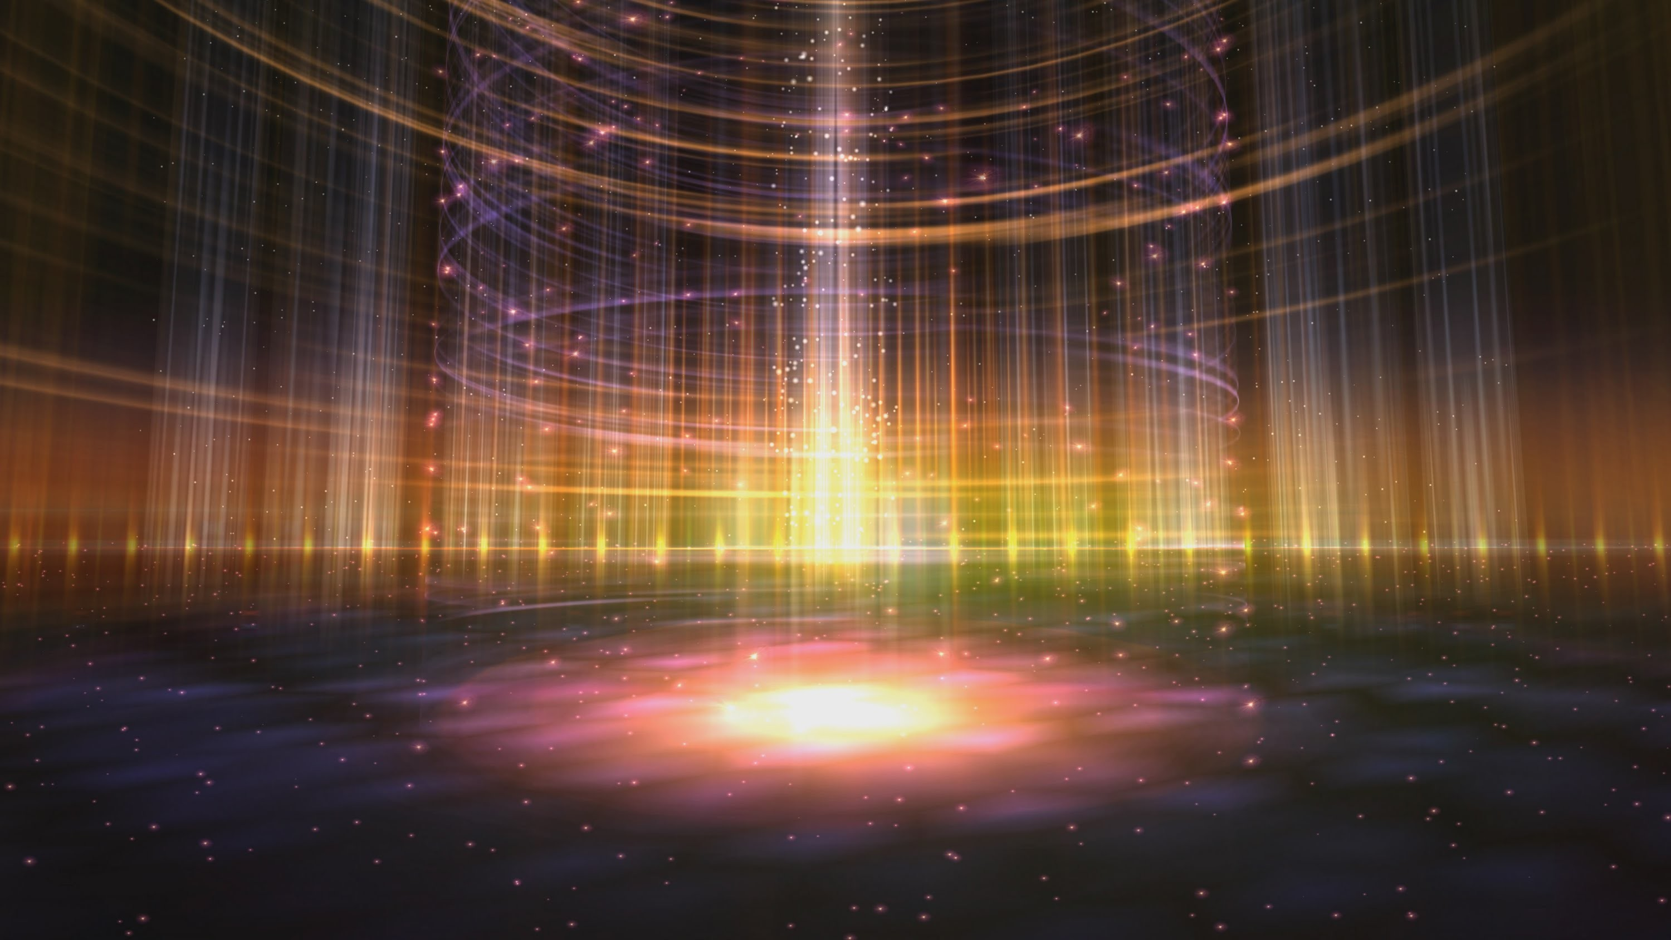
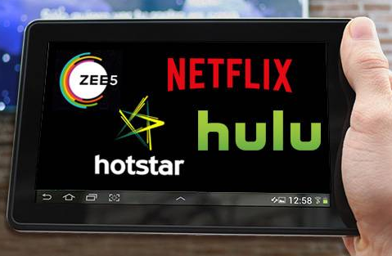
INDIAN MEDIA & ENTERTAINMENT
INDUSTRY

Slide 27
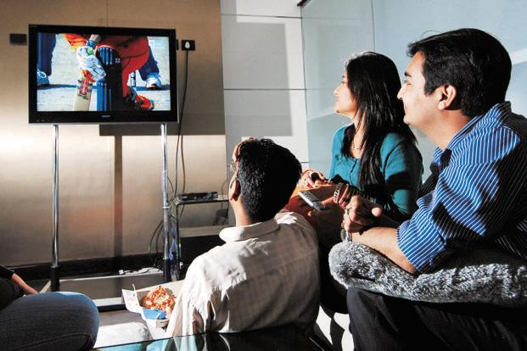
India produced and licensed around 750,000 hours of content in 2018
India’s Media Consumption growth is 9 times that of USA
Average Media Consumption is 4 hours, 34 mins each day in 2018
Netflix is investing US$ 1.1 Bn on animated content worldwide
Amazon invested US$ 30 Million on Indian local content

Slide 28
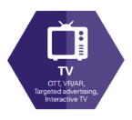
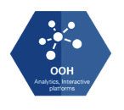
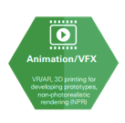
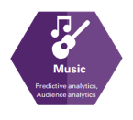
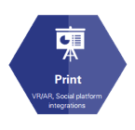
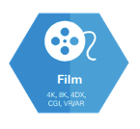
MEDIA & ENTERTAINMENT
9 SECTORS
Source : KPMG in India analysis 2018
Estimated to grow at CAGR 13.1% from 2018-2023 to reach Rs. 2,660 Billion

Slide 29
MEDIA & ENTERTAINMENT
GROWTH SECTORS
ANIMATION & VFX : 15.5%
GAMING : 22.1%
DIGITAL MEDIA : 30.2%
2018-2023
TOP GROWTH SECTORS

Slide 30
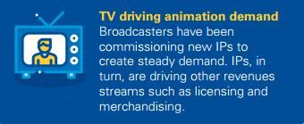
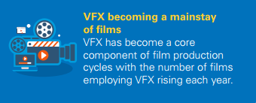
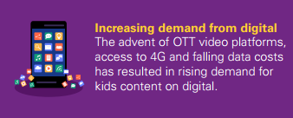
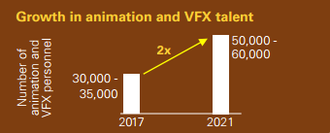
MEDIA & ENTERTAINMENT
ANIMATION & VFX

Slide 31
MEDIA & ENTERTAINMENT
ANIMATION & VFX
325 ANIMATION STUDIOS
64 VFX STUDIOS
275 GAMING STUDIOS

Slide 32
MEDIA & ENTERTAINMENT
ANIMATION & VFX STUDIOS
MUMBAI | PUNE | BANGALORE | HYDERABAD | CHENNAI | KOLKATA | DELHI & NCR | CHANDIGARH
DNEG STUDIOS | ANIBRAIN – FRAMESTORE | TECHNICOLOR INDIA | GREEN GOLD ANIMATION | DNEG Chennai | WACKYTOONS | LAKSHYA DIGITAL | VISUAL MEDIA
TECHNICOLOR – TRACE VFX | LEGEND 3D | MIKROS | DQ ENTERTAINMENT | BOT VFX | ANIMATZIONE STUDIO | DIGITOONZ | MORPH ANIMATION STUDIO
ASSEMBLAGE | METHOD STUDIOS | MR.X | FIREFLY CREATIVE STUDIO | PRISM & PIXELS VFX | FOURTH DIMENSION VFX | CITRUS INC. STUDIOS | RHODIUM STUDIO
GOLD ROBOT ANIMATION STUDIO | PHILM – CGI | THE MILL | MAKUTA VFX | MIST VFX | VIRTUAL INFOCOM | PIXEL 2 PIXEL | SUPREME ANIMATION STUDIO
COSMOS MAYA | TOOLBOX ANIMATION | MPC | PRIME FOCUS | FEATHER VFX | BFX CGI | CHARUVI DSIGN LABS | PHOENIX 3D ART
EPLUS STUDIOS | SVFX ANIMATION STUDIO | ROCKSTAR INDIA | ROTOMAKER | ANIMANTZ STUDIO | ZOETROPE ANIMATION STUDIO | SPARROW INTERACTIVE | FXUNIQUEFXUNIQUE
YRF STUDIOS | PHOEBUS CREATIONS | XENTRIX STUDIOS | DIGITAL DOMAIN | SPARKY ENTERTAINMENT | CRAZY ANIMATION | CRAZY CUB ANIMATION STUDIO | DNEG INDIA
RELIANCE ANIMATION | DELUXE ENTERTAINMENT | INFOBELLS INTERATIVE SOLUTIONS | 7 ACTIVE STUDIO | EFFE ANIMATION | STUDIOTLE | DOUBLE X STUDIOS | VIRTUALSOFT TECHNOLOGIES
DIGITAL DISTRICT | REDWING STUDIOS | ROLLING DICE STUDIOS | SRUSHTI VFX | VFX PICK STUDIO | GREEN GRASS PRODUCTION | SPACETIME STUDIOS | INCREDIMATE STUDIO
NY VFXWALA | RELIANCE ANIMATION | NUKEBOX STUDIOS | CGTRIX ANIMATION STUDIOS | PHANTOM DIGITAL EFFECTS | AFTERZ VFX STUDIO | MAGIC SPANGLE STUDIOS | CEDGE PRODUCTIONS
RGBA STUDIO | HMX MEDIA | STUDIO 56 ANIMATION | INFINITOVFX STUDIOS | ANIMAKER INC | SKYLARK STUDIO | DIGIMONKS PVT. LTD | CINEVIRE

Slide 33
ANIMATION ON DIGITAL
MEDIA & ENTERTAINMENT
ANIMATION SERVICES &
IP PRODUCTIONS
ANIMATION
ANIMATION ON TV
ANIMATION IN FILMS

Slide 34
ANIMATION SERVICES & IP PRODUCTION
Photo 1
Photo 3
Ut wisi enim ad minim veniam, quis nostrud exerci
Ut wisi enim ad minim veniam, quis nostrud exerci
COSMOS MAYA
COSMOS MAYA
EPLUS STUDIOS
TOONZ ANIMATION
Photo 5
Photo 6
Ut wisi enim ad minim veniam, quis nostrud exerci
Ut wisi enim ad minim veniam, quis nostrud exerci

Slide 35
ANIMATION ON TV
Photo 1
Photo 3
Ut wisi enim ad minim veniam, quis nostrud exerci
PAPERBOAT
DISCOVERY KIDS
Ut wisi enim ad minim veniam, quis nostrud exerci
GREEN GOLD
SONY YAY
RELIANCE ANIMATION
DISCOVERY KIDS
AUM ANIMATION
POGO
Photo 5
Photo 6
Ut wisi enim ad minim veniam, quis nostrud exerci
Ut wisi enim ad minim veniam, quis nostrud exerci

Slide 36
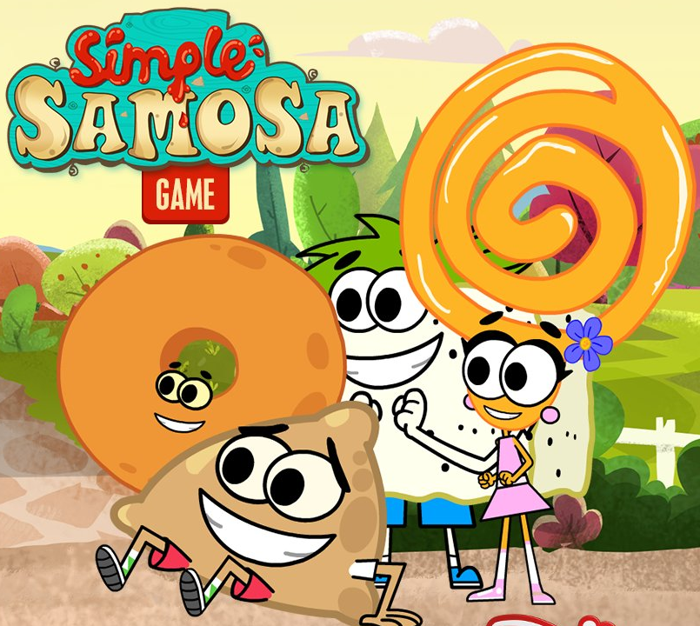
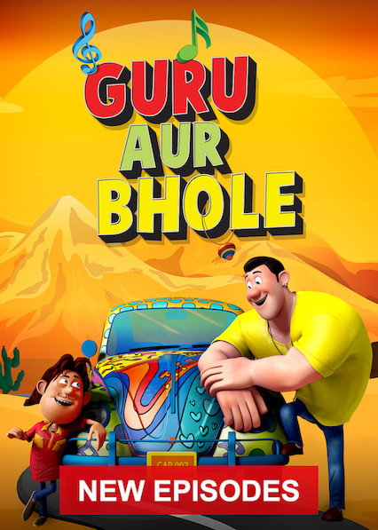
ANIMATION ON TV
GURU AUR BHOLE
SONY YAY
RUDRA
NICKELODEAN
Photo 3
Ut wisi enim ad minim veniam, quis nostrud exerci
SIMPLE SAMOSA
DISNEY
SHIVA RELOADED
SONIC
Photo 5
Photo 6
Ut wisi enim ad minim veniam, quis nostrud exerci
Ut wisi enim ad minim veniam, quis nostrud exerci

Slide 37
ANIMATION ON DIGITAL
Photo 1
Photo 3
Ut wisi enim ad minim veniam, quis nostrud exerci
GREEN GOLD
Ut wisi enim ad minim veniam, quis nostrud exerci
ANIMANTZ
TOONZ ANIMATION
COSMOS MAYA
Photo 5
Photo 6
Ut wisi enim ad minim veniam, quis nostrud exerci
Ut wisi enim ad minim veniam, quis nostrud exerci

Slide 38
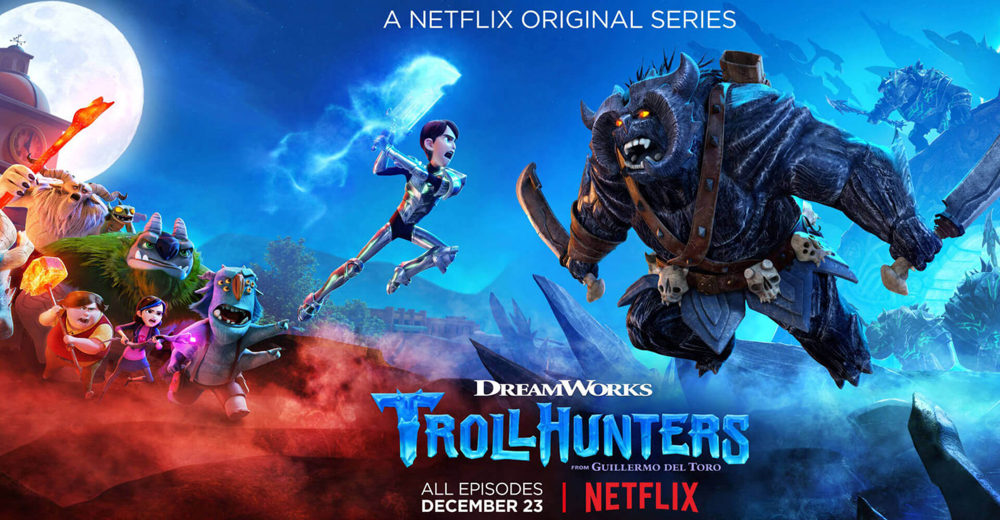
ANIMATION ON DIGITAL
“TROLLHUNTERS” BY 88 PICTURES, MUMBAI

Slide 39
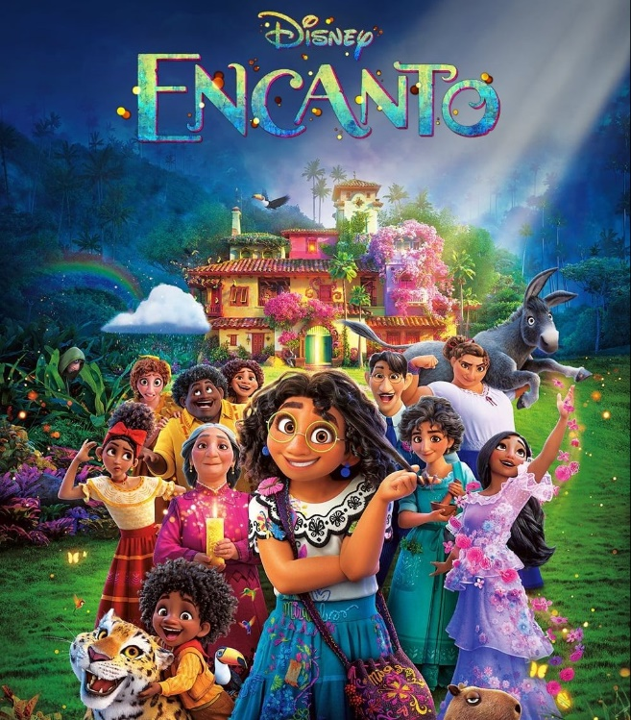
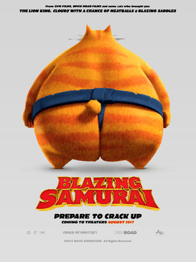
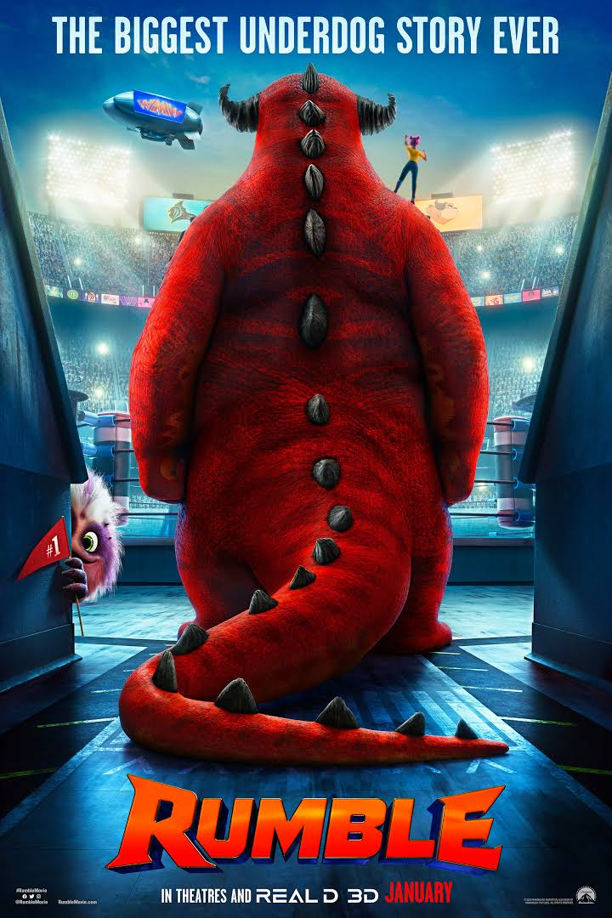
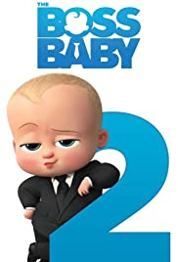
ANIMATION FILMS - 2021

Slide 40
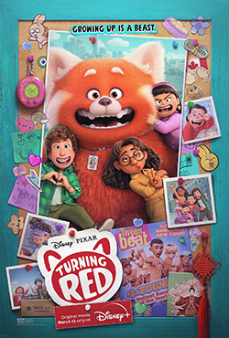
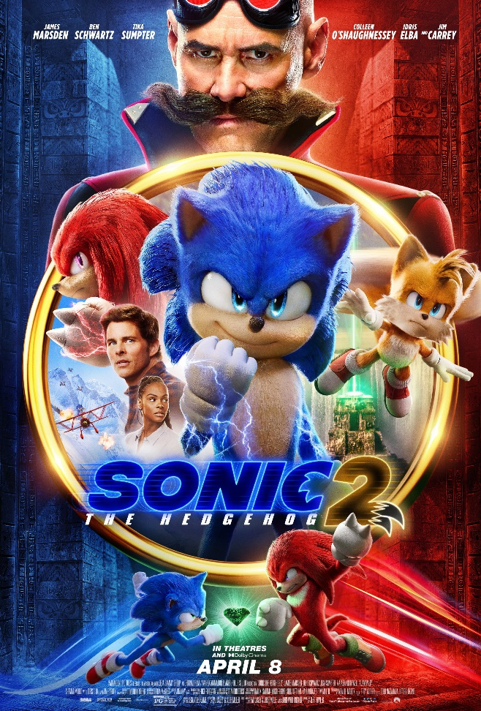
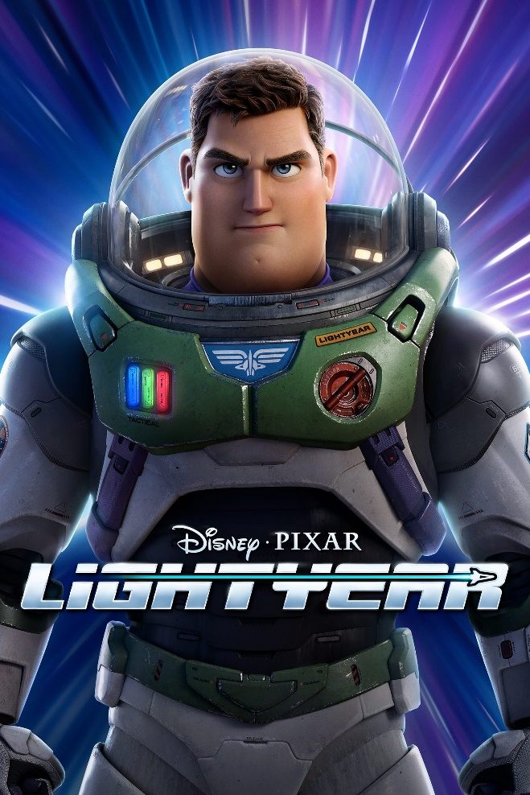
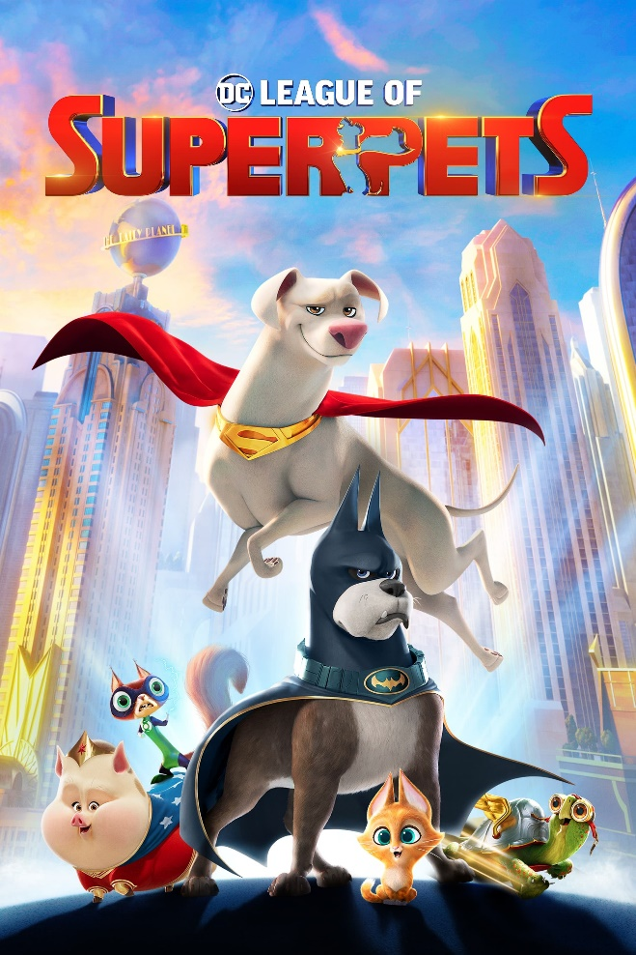
ANIMATION FILMS - 2022

Slide 41
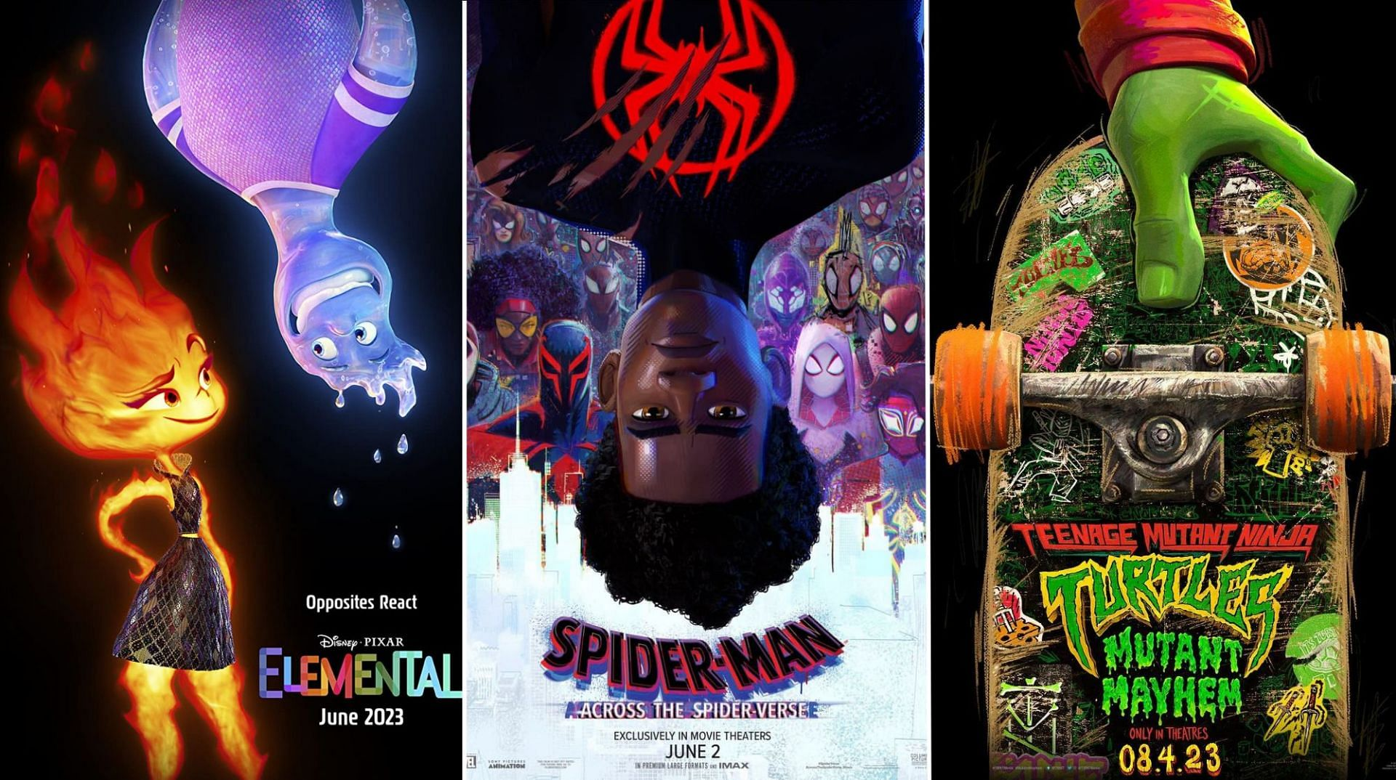
ANIMATION FILMS - 2023

Slide 42
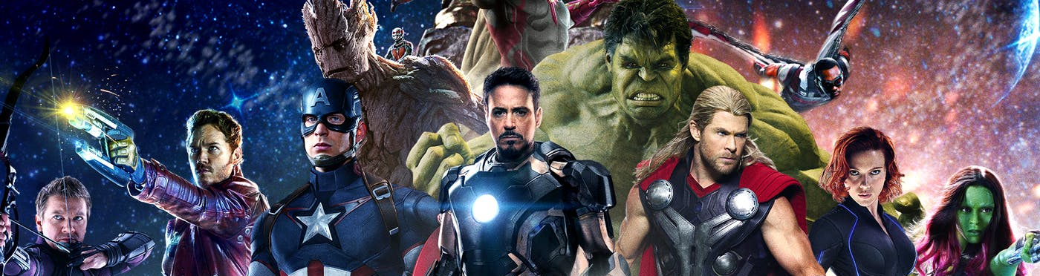
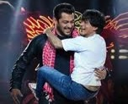
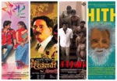
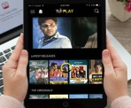
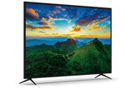
VISUAL EFFECTS / VFX
In MEDIA & ENTERTAINMENT
FILMS
REGIONAL FILMS
TV
DIGITAL

Slide 43
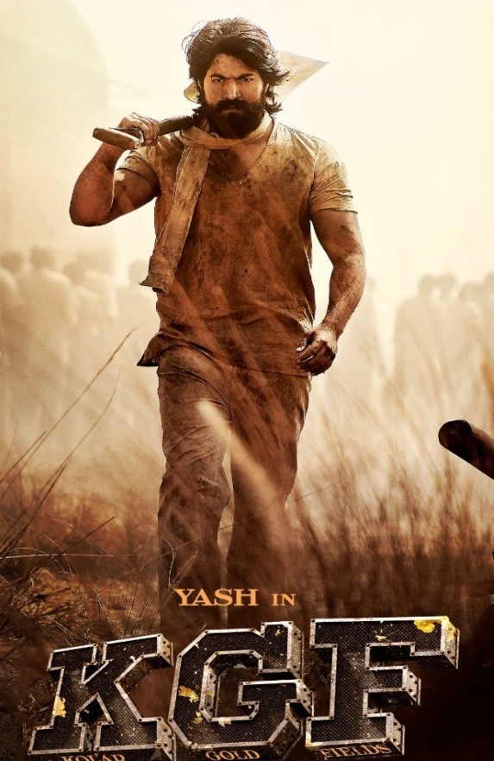
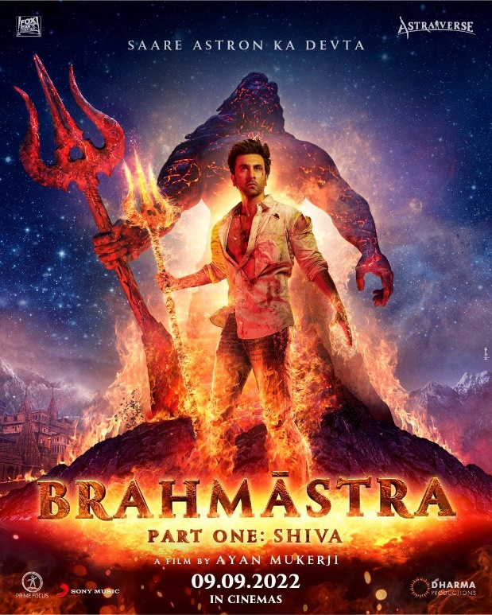
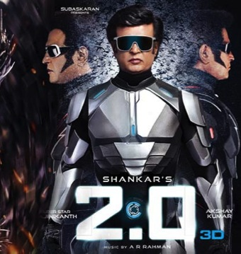
MEDIA & ENTERTAINMENT
VFX IN FILMS
VFX Revenue from Hollywood & International projects had a major share of 77.3%
Total Budget of Bahubali 1 & 2 was Rs. 430 Crore
Movie 2.0 was done with a VFX Budget of Rs. 100 Crore
Brahmastra was done with a VFX Budget of Rs. 100 Crore
Domestic VFX Industry grew at a rate of 30% Y-o-Y
Rapid Growth of VFX in Bollywood as well as regional Films

Slide 44
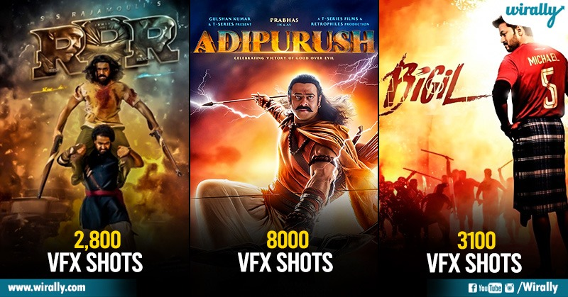

Slide 45
DNEG : VFX FOR VENOM
HOLLYWOOD VFX
DNEG
MPC
LEGEND 3D
FRAMESTORE
METHOD STUDIO
TRACE VFX
DIGITAL DOMAIN
VFX BY MPC

Slide 46
VFX IN ott / online digital content
Higher Budgets and Higher Production values to create more demand for VFX services from Digital
OTT Platforms besides Netflix & Amazon Prime are investing in VFX-led original content
Continuous Content innovation from OTT players in terms of visual appeal of the shows

Slide 47
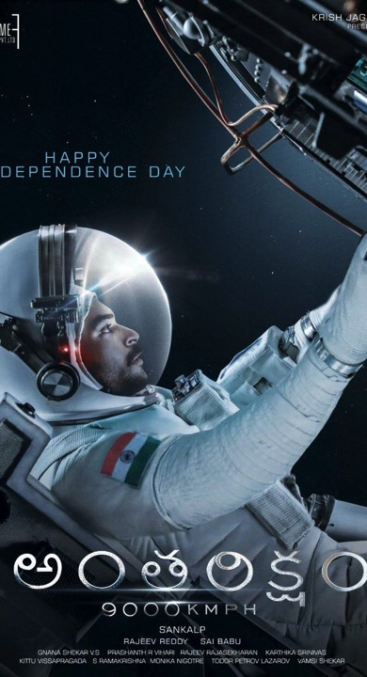
01
Ut wisi enim ad minim veniam, quis nostrud exerci tation ullamcorper nibh euismod tincidunt ut laoreet dolore magna aliquam erat volutpat.
MEDIA & ENTERTAINMENT
VFX
Regional Films
12 Marc 2017 12:45 PM
02
South Indian directors have been showcasing strong inclination towards more VFX shots in their films, bigger budgets to get more realism in shots
Ut wisi enim ad minim veniam, quis nostrud exerci tation ullamcorper nibh euismod tincidunt
12 Marc 2017 12:45 PM
03
Ut wisi enim ad minim veniam, quis nostrud exerci tation ullamcorper nibh euismod tincidunt ut laoreet dolore magna
12 Marc 2017 12:45 PM

Slide 48
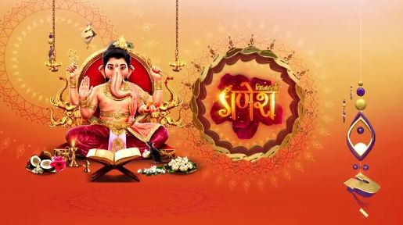
MEDIA & ENTERTAINMENT
VFX
in Television
ZERO
RED CHILLIES ENTERTAINMENT
Vighnaharta Ganesh & Porus are 2 shows which demonstrate the evolution of VFX in Indian TV
Star, Sony & Zee are provisioning higher budgets for VFX to maintain authenticity of storytelling for their shows

Slide 49
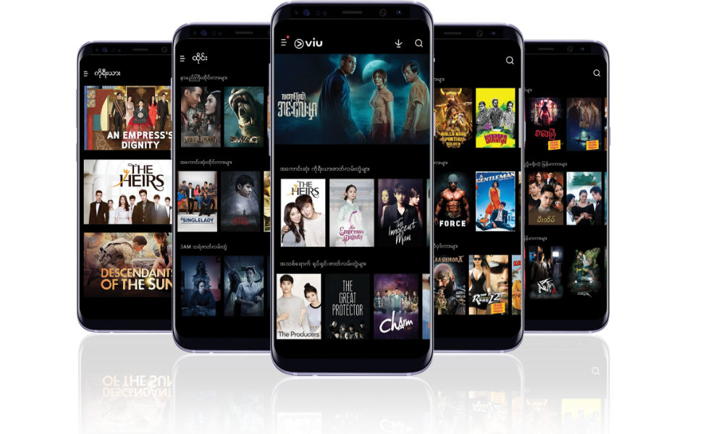
MEDIA & ENTERTAINMENT
DIGITAL MEDIA
VIDEO CONTENT CONSUMPTION
Video Consumption will continue to rise on the back of on-demand content on Digital platforms like OTT
Technology-led experiences are expected to drive interactions and transactions on digital platforms
Increase in Use of Voice Assistants – Alexa, Google Assistant by Consumers & more Companies will use AI for providing better customer service

Slide 50
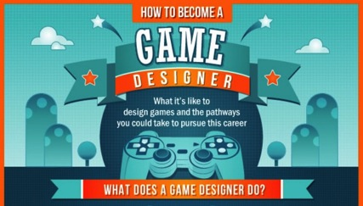
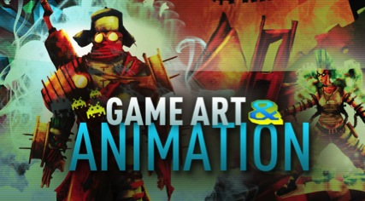
MEDIA & ENTERTAINMENT
GAMING
GAME ART & DESIGN

Slide 51
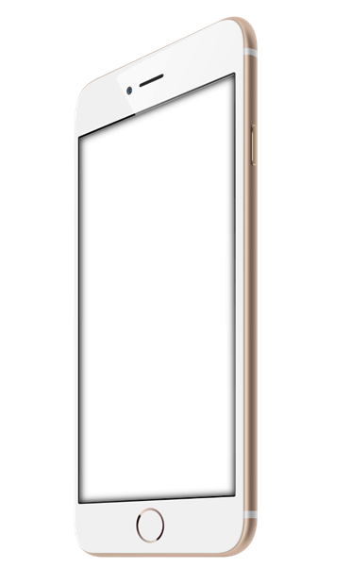
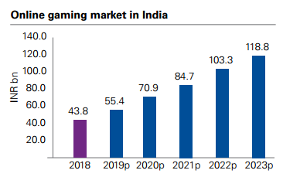
MEDIA & ENTERTAINMENT
GAMING
CAGR 22.1%
Source : KPMG in India analysis 2018

Slide 52
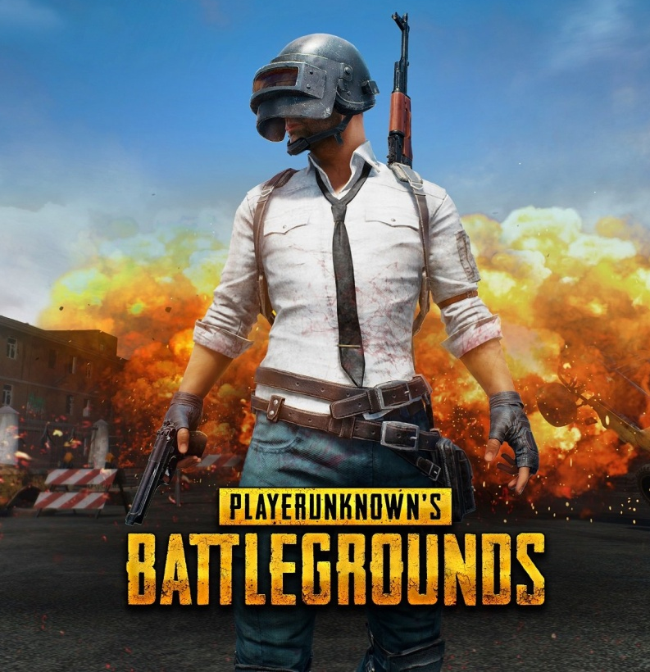
MEDIA & ENTERTAINMENT
MOBILE GAMING
Mobile Gaming leads from the front in India with nearly 89% of all gaming revenue in India generated from Mobile games
Online Gaming Industry has doubled in 5 years from Rs. 20.3 Bn in 2014 to Rs. 43.8 Bn in 2018

Slide 53
MEDIA & ENTERTAINMENT
ONLINE GAMING
Online Gamers in India grew 52% to 278 Million in 2018
5 Billion Game Apps were downloaded in 2018
India is now in Top 5 Markets for Mobile Gaming globally

Slide 54
MEDIA & ENTERTAINMENT
GAMING
AR, VR & MOBILE
The most successful mobile game creators rely on Unity
Publish for All Formats & All Platforms in Real-time
More than 50% of all new mobile games are created in Unity

Slide 55
MEDIA & ENTERTAINMENT
GAMING STUDIOS
DHRUVA INTERACTIVE
ROCKSTAR GAMES
LAKSHYA DIGITAL
YOOZOO GAMES
SUMO DIGITAL
NUKEBOX STUDIOS
MOONFROG LABS
NAZARA
NODDING HEAD GAMES
LITTLE RED ZOMBIES
99 GAMES
FLYING ROBOT STUDIOS
HOLY COW PRODUCTIONS
OGREHEAD STUDIOS
APAR GAMES
MINDBOX
LUCID LABS
SMARTVIZX

Slide 56
ZICA PROGRAMS
ANIMATION
VISUAL EFFECTS
GAMING
FASHION DESIGN
INTERIOR DESIGN
GRAPHIC & WEB DESIGN
DIGITAL MARKETING
PHOTOGRAPHY
EDITING
2018-2023
TOP GROWTH SECTORS

Slide 57
ZICA CAREER PROGRAMS
PROFESSIONAL CAREER DEVELOPMENT PROGRAMS
PCDP IN ANIMATION VISUAL EFFECTS
PROFESSIONAL DEVELOPMENT PROGRAMS
PDP IN 3D ANIMATION VISUAL EFFECTS
PDP IN FILM MAKING VISUAL EFFECTS
PDP IN FASHION DESIGN
PDP IN INTERIOR DESIGN
PROFESSIONAL PROGRAMS:
PP IN 2D ANIMATION
PP IN 3D ANIMATION
PP IN VISUAL EFFECTS
PP IN ADV GAME ART & DESIGN
PP IN FASHION DESIGN
PP IN INTERIOR DESIGN
PP IN GRAPHIC DESIGN

Slide 58
PCDP IN ANIMATION VISUAL EFFECTS
LEARNING OBJECTIVE:
This is a comprehensive certificate program that deals with all the important aspects of 2D, 3D & Visual Effects. The student begins with learning all the creative development exercises with manual and digital 2D animation processes. The second module starts with all the basic elements of 3D digital art which in the later module progresses into advanced 3D Digital art and character animation. The remaining modules of the program deal with different aspects of Dynamics, tracking, and advanced Visual effects which are generally used in production studios.
5 Days a week (Monday to Friday)
Everyday 2 Hrs. (Theory – 1 Hr. & Practical 1 Hr.)
Duration: 36 Months
Total Hours: 1440 Hours
Theory: 641 Hrs.
Practical: 641 Hrs.
Project: 158 Hrs.
Saturday – Workshop / Activity

Slide 59
PCDP IN ANIMATION VISUAL EFFECTS
MODULE - 1
Preface Sketching Human Figure Study Animal Study Perspective Study Colour Theory Story Master Layout Design Character Design Digital Illustration Storyboard Computer Graphics Digital 2D Animation
Photoshop Illustrator Animate
MODULE - 2
Video & Audio Editing Stop-motion Prop Modeling Character Modeling Texturing Lighting & Shading Rigging
Premiere Audition Maya Arnold
MODULE - 3
3D Character Animation Advance Modeling & Sculpting Advanced Texturing Advanced Lighting
Maya Z-Brush Substance painter Arnold Nuke

Slide 60
PCDP IN ANIMATION VISUAL EFFECTS
MODULE - 4
Advance Character Animation Dynamics Technical Animation Liquid Simulation Motion Graphics Compositing
Maya X-Gen Plugin RealFlow After Effects Element 3D
MODULE - 5
Digital 2D Tracking Masking, Rotoscope Colour Correction Compose 3D render passes Keying Tracking Stabilize Particles Paint Wire / Rig Removal Camera Projection Camera tracking Re-lighting
Mocha Fusion Nuke Silhouette
MODULE - 6
Automatic tracking Manual tracking Object tracking Face tracking Camera solving Pyro FX POP Solver Flip Solver Ocean Solver Introduction to AR & VR
PFTrack 3D Equalizer Syntheyes Houdini Unity

Slide 61
PCDP IN ANIMATION VISUAL EFFECTS
LEARNING OUTCOME:
PLACEMENT OPPORTUNITIES
The program completed students can work on multiple profiles such as Illustrator, Character designer, 3D Digital artist, Modeling specialist, Texturing artist, Character animator, CHF Technician, Compositor, VFX / Post-production supervisor, etc. These candidates can get fit into current needs as a generalist with a specialized skillset with most of the production studios.
Product Designer
Texture Artist
Lighting Technician
Character Rigger
Character Animator
Roto Artist
Matchmover
Matte Painter
Pipeline TD
VFX Producer
CG Supervisor
VFX Supervisor
Compositing Artist
Effects Animator
Render Wrangler
Tracking Artist

Slide 62
PDP IN 3D ANIMATION VISUAL EFFECTS
LEARNING OBJECTIVE:
This program begins with the Fundamentals of Art and Design, Digital Painting and Digital 2D Animation which is necessary for 3D Animation. The program follows with Visual Effects where students can create amazing effects, compose live and CG footage, Paint, Color correct etc. Afterwards, the student can select any one specialization from four different options where they decide to make their career. They will also learn how Augmented and Virtual Reality works.
Character Modeling
Lighting & Shading
3D Character Animation
Visual Effects
Students will also learn the application of AR & VR in animation.
5 Days a week (Monday to Friday)
Everyday 2 Hrs. (Theory – 1 Hr. & Practical 1 Hr.)
Duration: 27 Months
Total Hours: 1116 Hours
Theory: 479 Hrs.
Practical: 479 Hrs.
Project: 158 Hrs.
Saturday – Workshop / Activity

Slide 63
PDP IN 3D ANIMATION VISUAL EFFECTS
MODULE - 1
Preface Sketching Human Figure Study Animal Study Perspective Study Colour Theory Story Master Layout Design Character Design Digital Illustration Storyboard Computer Graphics Digital 2D Animation
Photoshop Illustrator Animate
MODULE - 2
Video & Audio Editing Stop-motion Prop Modeling Character Modeling Texturing Fundamental Advance Texturing Lighting & Shading
Premiere Audition Maya Substance Painter Arnold
MODULE - 3
Character Rigging 3D Character Animation Maya Motion Maya Dynamics Maya Technical Animation
Maya Mash Plugin Xgen Plugin Bifrost Plugin
MODULE - 4
Motion Graphics Compositing Masking, Rotoscope Colour Correction Compose render passes Keying, Tracking Stabilize Particles, Paint Wire Removal Camera Projection Re-lighting Specialisation (Anyone) Character Modeling Lighting and Shading Character Animation Visual Effects
MODULE - 5
Introduction to AR & VR Project Development
Unity 3D
After Effects
Fusion
Nuke
Maya
Arnold
Z-Brush
V-Ray
3D Equalizer

Slide 64
PDP IN 3D ANIMATION VISUAL EFFECTS
LEARNING OUTCOME:
PLACEMENT OPPORTUNITIES
The Certificate holder will have a very bright prospect in the Animation or Visual Effects studios. He / She will have the ability to contribute to any / all departments of the production pipeline, with a clear understanding of the fundamentals. They will become indispensable for any Animation or VFX production studio.
Graphic Designer
Storyboard Artist
Character Designer
2D Animator
Background Painter
Stop Motion Animator
Architectural Animator
Product Designer
Texture Artist
Lighting Technician
Character Rigger
Character Animator
Roto Artist
Matchmover
Matte Painter
Pipeline TD
Compositing Artist
Effects Animator
Render Wrangler
Video Game Designer

Slide 65
PDP IN FILM MAKING VISUAL EFFECTS
5 Days a week (Monday to Friday)
Everyday 2 Hrs. (Theory – 1 Hr. & Practical 1 Hr.)
Duration: 24 Months
Total Hours: 998 Hours
Theory: 467 Hrs.
Practical: 467 Hrs.
Project: 64 Hrs.
Saturday – Workshop / Activity
LEARNING OBJECTIVE:
This program has been designed to deal with Filmmaking by using Live Action, 3D Animation & Visual Effects. The first module deals with the Fundamentals of Art, Design & Composition. A student then understands the basics of Photography and Filmmaking. The second module covers CG Assets & Characters, Rigging & Animation that is required for a VFX film. The third module deals with Dynamics & Tracking. The fourth module combines CG with live action footage using timelines and a node-based compositing software. At the end of the program, the student develops a Visual Effects short film using Live Action & CG.

Slide 66
PDP IN FILM MAKING VISUAL EFFECTS
MODULE - 1
Fundamentals of Art Computer Graphics Principles of Design Perspective Colour Theory Storyboard Filmmaking Foundation Screen Writing Direction Acting Cinematography Film Editing Sound Editing
Photoshop Premiere Audition
MODULE - 2
3D Character Modeling Texturing Lighting & Shading Rigging Animation Maya Motion Particles and Dynamics Technical Animation
Maya Arnold Mash Plugin Xgen Plugin Bifrost Plugin
MODULE - 3
Liquid Simulation Soft & Rigid body dynamics Daemon & Hybrido Motion Graphics Compositing Masking, Rotoscope Colour Correction Render passes, Keying Tracking Stabilize Particles, Paint Wire / Rig Removal Camera Projection Re-lighting
RealFlow After Effects Element 3D Plug-ins Fusion Nuke
MODULE - 4
Stereo conversion Advance tracking Track stereo footage Advance motion blur roto Planner tracker Mocha Tracker Hair Roto Roto using IK Advanced Keying Complex Wire Removal Set Extension Advance Particles Introduction to AR & VR
Boris Mocha 3D Equalizer Silhouette Foundry Nuke Syntheyes Unity

Slide 67
PDP IN FILM MAKING VISUAL EFFECTS
LEARNING OUTCOME:
PLACEMENT OPPORTUNITIES
The emerging student will have a complete understanding of the different modules of Visual Effects and film making, which will help in attaining a bright career. The VFX certificate holder will be capable of delivering outstanding VFX shots due to his / her extensive knowledge in areas like Live Action shooting, 3D Animation, Advanced Dynamics, Tracking & Compositing etc.
Product Designer
Texture Artist
Lighting Technician
Character Rigger
Character Animator
Roto Artist
Matchmover
Matte Painter
Pipeline TD
VFX Producer
CG Supervisor
VFX Supervisor
Compositing Artist
Effects Animator
Render Wrangler
Tracking Artist

Slide 68
PDP IN FASHION DESIGN
5 Days a week (Monday to Friday)
Everyday 2 Hrs. (Theory – 1 Hr. & Practical 1 Hr.)
Duration: 24 Months
Total Hours: 998 Hours
Theory: 467 Hrs.
Practical: 467 Hrs.
Project: 64 Hrs.
Saturday – Workshop / Activity
LEARNING OBJECTIVE:
The two year program in Fashion Design is about creative exploration. You will have an introduction to a wide range of creative practices. This will give you the chance to try different disciplines. Through a range of activities you will start to think about your own creative ambition. You will consider your own work in relation to your chosen professional practice. You will come up with an idea for a project proposal. You will research, write and evaluate your proposal. From this you will produce a body of work for your final assessment.

Slide 69
PDP IN FASHION DESIGN
MODULE - 1
Drawing + geometry Basic design - elements and principals of design + colour theory Fashion model drawing + illustration Design project – theme concept mood board Basic pattern making Basic garment construction History of art & design -Indian and Western Introduction to embroideries -Basic Embroidery and Indian Embroidery Textile Science 1 – Fiber to Fabric Communication Skills, Body Language, Self-discipline, Integrity
MODULE - 2
Introduction to CAD -PHOTOSHOP and ILLUSTRATOR (CORELDRAW) Basic Draping -Draping skirt and Bodice DESIGN PROJECT -I–(SKIRT) Research - Design development -Theme Concept Mood board - Pattern Making -Garment Construction DESIGN PROJECT -II–(DRESS) Research -Design development -Theme Concept Mood board -Pattern Making -Garment Construction HISTORY OF TEXTILES Indian and Western FASHION MARKETING FASHION FORECASTING - MARKET RESEARCH Textile Science 2 – Dyeing and Printing Business Ethics & Etiquette, Physical Wellness, Positive Attitude, Time Management
CAD Photoshop Illustrator / CorelDraw

Slide 70
PDP IN FASHION DESIGN
MODULE - 3
Design project – draping –draped dress Design project -iii–(evening wear) research -design development -theme concept mood board -pattern making -garment construction Design project -iv–(ethnic wear) research -design development -theme concept mood board -pattern making -garment construction CAD for fashion and textiles Fashion merchandising Managing export-import business Manufacturing methods & process and quality control Portfolio development • Grooming & Etiquette • Communication Skills • Interview Skills • Personal Effectiveness • Information Technology Traineeship
MODULE - 4
Project styling - for films - advertisement Textile- product development Fashion photography Fashion accessories Design project -v–(final collection ) research -design development -theme concept mood board -pattern making -garment construction Portfolio Resource management Execution skills Result orientation Values and belief system, goal setting traineeship

Slide 71
PDP IN FASHION DESIGN
LEARNING OUTCOME:
PLACEMENT OPPORTUNITIES
This course enables students to be professional fashion Designer and work in the industry of Apparel, Export Houses, Garment manufacturing, fashion retail stores, Online fashion business, blogger, as a Stylist in the Media and film industry etc. As an entrepreneur students also learn how to launch their brands, open boutique and fashion store.
Fashion Designer
Textile Designer
Visual Merchandiser
Garment Designer
Accessories Designer
Graphic & Textile Designer Technical
Fashion Graphic Designer
Apparel Fashion Designer
Fashion Stylist

Slide 72
PDP IN INTERIOR DESIGN
5 Days a week (Monday to Friday)
Everyday 2 Hrs. (Theory – 1 Hr. & Practical 1 Hr.)
Duration: 24 Months
Total Hours: 998 Hours
Theory: 467 Hrs.
Practical: 467 Hrs.
Project: 64 Hrs.
Saturday – Workshop / Activity
LEARNING OBJECTIVE:
The Interior design program deals with the art and science of enhancing the interior of a building's inner space to achieve a healthier more aesthetically pleasing and functional environment for the people using the space. In this program, we develop the design, art, fundamentals of drawing, furniture design, and design source and materials, interior graphics, Introduction to CAD, construction, services, case study, building material, etc. To become a professional Interior Designer. This program offers exposure to new technologies like AR/ VR to help the students to be future-ready

Slide 73
PDP IN INTERIOR DESIGN
MODULE - 1
History of Interior furniture Design (Indian & Western) Concept of Interior Design Fundamental of Art Free-Hand Drawing Design development Space planning Services, Techniques, Theory & Practical
CAD Google SketchUp
MODULE - 2
Architectural Drafting Interior Design – Residential 2D, 3D Computer Aided Drawing (CAD, Sketch-up, 3D Model making, AR/VR) Computer Graphic Skills Creativity and Concept Development BOQ, Budget and Costing Drawing Presentation Application and Execution Introduction of AR & VR Portfolio
CAD Google SketchUp 3D (Model Making)

Slide 74
PDP IN INTERIOR DESIGN
MODULE - 3
Furniture History and Application Design Studio workshop 2 - Retail Construction Studies Services- Plumbing, Lighting, AC, etc. Computer Rendering Walkthrough
Adobe Illustrator Adobe Photoshop CAD 3D Drawings Google SketchUp
MODULE - 4
Design Studio workshop 3 - Office Design Studio workshop 4 - Restaurant & Hospitality Academic Research and Communication Skills Industrial experience, Internship Application and Execution Portfolio (by using AR & VR)
CAD Google SketchUp 3D (Walkthrough)

Slide 75
PDP IN INTERIOR DESIGN
LEARNING OUTCOME:
PLACEMENT OPPORTUNITIES
The course-completed student can be Interior Designer and works for Residential Space Designing Firm, Commercial Space Designing, Office Space Designing, Retail Space Designing, Hospitality Space Designing, Public Space Designing, Exhibition Space Designing, Merchandising designer, Stall Designer, Event and Set Designer in entertainment, Furniture designer, Art direction, Design Consulting, Colour consultant, Design Entrepreneur
Interior Designer
Retail Space Designer
Event Set Designer
Design Consultant
Art Director
Stall Designer
Space Designer

Slide 76
PROFESSIONAL PROGRAM IN 2D ANIMATION
5 Days a week (Monday to Friday)
2 Hrs. a Day (Theory – 1 Hr. & Practical 1 Hr.)
Duration: 12 Months
Total Hours: 496 Hours
Theory: 233 Hrs.
Practical: 233 Hrs.
Project: 30 Hrs.
Saturday – Workshop / Activity
LEARNING OBJECTIVE:
This program has been developed based on the current requirement of 2D Animators in the world. The prerequisite for the program is good drawing skills. Student will learn all the aspects of 2D Animation film making from Pre-production, Production and Post production. Student will initially learn fundamental of Art and design by manual drawing and then they will learn character design, background painting, character animation, audio and video editing by using advance digital tools.

Slide 77
PROFESSIONAL PROGRAM IN 2D ANIMATION
MODULE - 1
Preface Principles of Design Sketching Still life Cartoon Drawing Computer Graphics Human Figure Study Anatomy study Animal Study (Skeleton) Perspective Study Colour Theory Story Character design Master Layout Design Layout & Background
Photoshop
MODULE - 2
Video Editing Audio Editing Storyboard Stopmotion Digital 2D Animation Acting for Animation Bio-Mechanics or Organic Animation (Digital) Special effects (Digital) Project
Premiere Audition Animate

Slide 78
PROFESSIONAL PROGRAM IN 2D ANIMATION
LEARNING OUTCOME:
PLACEMENT OPPORTUNITIES
There is huge demand for 2D animation series on TV and OTT platform as they are very simple drawings, much focus on the storytelling, action and exaggeration which kids love the most. Looking at this the production studios across the world are hiring massively the 2D artists.
Pre-production artist
Character designer
Storyboard artist
Layout background artist
Art Director
2D Animator
Visualizers
Illustrator
BG Painter
Lip-Sync Artist
Visual Artist
Motion Graphic Artist
Video Editor
2D FX Artist

Slide 79
PROFESSIONAL PROGRAM IN 3D ANIMATION
5 Days a week (Monday to Friday)
2 Hrs. a Day (Theory – 1 Hr. & Practical 1 Hr.)
Duration: 12 Months
Total Hours: 496 Hours
Theory: 233 Hrs.
Practical: 233 Hrs.
Project: 30 Hrs.
Saturday – Workshop / Activity
LEARNING OBJECTIVE:
This program has been developed to provide specialized knowledge in 3D Animation. It covers the Fundamentals of Art and Design after which students are exposed to the detailed 3D module. At the end of the program, there will be three elective specializations such as Modeling & Texturing, Lighting and Animation.

Slide 80
PROFESSIONAL PROGRAM IN 3D ANIMATION
MODULE - 1
History of Animation Principles of Design Fundamentals of Drawing Still Life Colour Theory Computer Graphics Background Painting Matte Painting
Photoshop
MODULE - 2
3D Character Modeling Texturing Lighting & Shading Rigging Animation
Maya Arnold
MODULE - 3
Digital Compositing Motion Graphics Rotoscope Keying Colour Correction Camera Projection Video Editing
After Effects Premiere
MODULE - 4
Specialisation (Anyone) Character Modeling Lighting and Shading Character Animation Portfolio Development
Z-Brush Maya Arnold Nuke

Slide 81
PROFESSIONAL PROGRAM IN 3D ANIMATION
LEARNING OUTCOME:
PLACEMENT OPPORTUNITIES
The student shall be well versed in 3D Content Development in any 3D production studio. The specialisation will help the student to build a career in 3D Animation within a short span of time.
Illustrator
Storyboard Artist
Character Designer
Architectural Animator
Product Designer
Texture Artist
Lighting Technician
Character Rigger
Character Animator
Matte Painter
Motion Graphic Artist
Pipeline TD
Render Wrangler

Slide 82
PROFESSIONAL PROGRAM IN VISUAL EFFECTS
5 Days a week (Monday to Friday)
2 Hrs. a Day (Theory – 1 Hr. & Practical 1 Hr.)
Duration: 12 Months
Total Hours: 496 Hours
Theory: 233 Hrs.
Practical: 233 Hrs.
Project: 30 Hrs.
Saturday – Workshop / Activity
LEARNING OBJECTIVE:
This program provides a gateway to the Visual Effects world. The program starts with the Fundamentals of Film Making & Computer Graphics. Then the program introduces the students to 3D Computer Graphics for a short period, thereby strengthening their skills in Dynamics, Tracking, Rotoscopy and Compositing, which forms the foundation for Visual Effects. A student will compile different kinds of VFX shots to build an outstanding portfolio during the last month of the program.

Slide 83
PROFESSIONAL PROGRAM IN VISUAL EFFECTS
MODULE - 1
History of VFX Principles of Design Photography Computer Graphics Film Making Video Editing Audio Editing
Photoshop Premiere Audition
MODULE - 2
Basics of Modeling Basics of Texturing Basics of Lighting Basics of Rigging Basics of Animation
Maya Arnold
MODULE - 3
Dynamics Particles Emitters Fluid Effects Soft Body Rigid Body Technical Animation Fur Hair nCloth nDynamics nParticle
Maya Xgen plugin Bifrost Plug-in
MODULE - 4
Motion Graphics Compositing Masking, Rotoscope Colour Correction Compose 3D render passes Keying Tracking & Stabilize Particles Paint Wire / Rig Removal Camera Projection Camera tracking Re-lighting
After Effects Nuke Mocha 3D Equalizer

Slide 84
PROFESSIONAL PROGRAM IN VISUAL EFFECTS
LEARNING OUTCOME:
PLACEMENT OPPORTUNITIES
The student will acquire skills that are needed to excel in any Visual Effects Studio as a Compositing Artist. Good understanding of Design, aesthetics of filmmaking along with strong fundamentals of Visual Effects will make this candidate, an advantage for any VFX team.
Matte Painter
Video Editor
Roto Artist
Matchmover
Pipeline TD
VFX Producer
CG Supervisor
VFX Supervisor
Compositing Artist
Effects Animator
Render Wrangler
Tracking Artist
Paint artist
Color correction artist

Slide 85
PROFESSIONAL PROGRAM IN GRAPHIC DESIGN
5 Days a week (Monday to Friday)
2 Hrs. a Day (Theory – 1 Hr. & Practical 1 Hr.)
Duration: 12 Months
Total Hours: 496 Hours
Theory: 233 Hrs.
Practical: 233 Hrs.
Project: 30 Hrs.
Saturday – Workshop / Activity
LEARNING OBJECTIVE:
Graphic designers create visual concepts to communicate ideas that inspire, inform or captivate consumers. Students will develop the overall layout and production design for advertisements, brochures, magazines and corporate reports. The graphic design industry has been evolved with a more presentable design due to which we have updated the program with the latest tools and technologies so that student can create outstanding artworks.

Slide 86
PROFESSIONAL PROGRAM IN GRAPHIC DESIGN
MODULE - 1
Fundamentals of Drawing Principle of Design Colour Theory Digital Illustrations Design – Logo, Magazine cover, Advertisement Computer Graphics Page layout Poster design Page layout for newspaper Creating brochure design Create advertisements
Photoshop Illustrator CorelDraw
MODULE - 2
Page layout design (Lookbook & Newspaper, Packaging design) Printing techniques Video Editing Motion Graphics User Interface design Design, prototyping & collaboration Create the Prototype Project Social media AD design Photorealistic 3D Design Project (Design for mock Company)
InDesign Premiere Audition After Effects Adobe XD Figma Dimension

Slide 87
PROFESSIONAL PROGRAM IN GRAPHIC DESIGN
LEARNING OUTCOME:
PLACEMENT OPPORTUNITIES
Many of Graphic Designers are employed in specialized design services, publishing or advertising, public relations, and related service industries. Majority of them become self-employed or freelancers due to the rising demand for quality designers.
Art Production Manager
Graphic Designer
Brand identity Developer
Logo Designer
Marketing Designer
Illustrator
Visual Image Developer
Multimedia Developer
Corporate Designer
Layout artist
Package Designer

Slide 88
GAMING
5 Days IN a week (Monday to Friday)
2 Hrs. a Day (Theory – 1 Hr. & Practical 1 Hr.)
Duration: 6 Months (Each program)
Total Hours: 248 Hours
Theory: 119 Hrs.
Practical: 119 Hrs.
Project: 10 Hrs.
Saturday – Workshop / Activity
LEARNING OBJECTIVE:
Gaming is a highly inspiring sector where professionals are needed who have a good balance of creativity, fun and technology. The most important skills required in this field are creativity and passion. In these programs student will learn to concept game art, storyboard, digital paint, matte paint the scenery, create objects / props, characters, environment, level design, game integration and development.

Slide 89
GAMING
PROFESSIONAL PROGRAM IN ADVANCED GAME ART & DESIGN
(12 Months)
PROGRAM IN GAME ART (6 Months)
The concept of game art Sketching Digital painting Matte painting Inorganic / Prop modeling Human figure study Character design Organic / character modeling Texturing Lighting Rigging Animation principles Character animation Portfolio
Photoshop Maya Unity (Lighting) / Unreal
PROGRAM IN ADVANCED GAME ART & DESIGN (6 Months)
Human sculpting Skeleton & Muscle study Low res of character Rules of gaming UV Character Design study Animal study Anthropomorphic Characters Texturing Cloths Texturing Face Presenting the Assets in Engine Foliage, Emitter, Particles/FX Level Design Portfolio
Z-Brush Substance Painter Maya Unity / Unreal
This is the combination of both programs
Program in Game Art
Program in Advanced Game Art & Design

Slide 90
GAMING
LEARNING OUTCOME:
PLACEMENT OPPORTUNITIES
The 3D gaming industry, unbelievably, has attained a large popularity and has become a hub for income generating business. 3D video game design and development can be carried out both as a profession and as a hobby. There are several websites that enable multiplayer games and online games and are constantly on a look out for new game developers and designers.
Game asset creator
Character modeler
Texturing Artist
Concept Art Designer
Lighting Artist
Character Designer
Game environment artist
3D Game designer
Game tester
Level designer
Game project manager

Slide 91
PROFESSIONAL PROGRAM IN FASHION DESIGN
5 Days a week (Monday to Friday)
Everyday 2 Hrs. (Theory – 1 Hr. & Practical 1 Hr.)
Duration: 12 Months
Total Hours: 496 Hours
Theory: 233 Hrs.
Practical: 233 Hrs.
Project: 30 Hrs.
Saturday – Workshop / Activity
LEARNING OBJECTIVE:
Fashion design is the art of the application of design and aesthetics or natural beauty to clothing and accessories. The Program is a multifaceted profession which includes the creative process as well as the mastering of technical skills. Research and experimentation is encouraged with the whole range of creative approaches
The course is structured to provide updated technical skills and relevant knowledge and new technical skills to gain an edge at the workplace. The core skills offered in this program are Research, Design development, Patternmaking and garment manufacture and production technology, Marketing merchandising to become professional in Fashion Design.

Slide 92
PROFESSIONAL PROGRAM IN FASHION DESIGN
MODULE - 1
Drawing + geometry Basic design - elements and principals of design + colour theory Fashion model drawing + illustration Design project – theme concept mood board Basic pattern making Basic garment construction History of art & design -Indian and Western Introduction to embroideries -Basic Embroidery and Indian Embroidery Textile Science 1 – Fiber to Fabric Communication Skills, Body Language, Self-discipline, Integrity
MODULE - 2
Introduction to CAD -PHOTOSHOP and ILLUSTRATOR (CORELDRAW) Basic Draping -Draping skirt and Bodice DESIGN PROJECT -I–(SKIRT) Research - Design development -Theme Concept Mood board - Pattern Making -Garment Construction DESIGN PROJECT -II–(DRESS) Research -Design development -Theme Concept Mood board -Pattern Making -Garment Construction HISTORY OF TEXTILES Indian and Western FASHION MARKETING FASHION FORECASTING - MARKET RESEARCH Textile Science 2 – Dyeing and Printing Business Ethics & Etiquette, Physical Wellness, Positive Attitude, Time Management
CAD Photoshop Illustrator / CorelDraw

Slide 93
PROFESSIONAL PROGRAM IN FASHION DESIGN
LEARNING OUTCOME:
PLACEMENT OPPORTUNITIES
This Certificate holder professional will have a very bright prospect in the Fashion Design field. Have the ability to contribute to all the departments of Fashion Design with a clear understanding
Fashion Designer
Textile Designer
Visual Merchandiser
Garment Designer
Accessories Designer
Graphic & Textile Designer Technical
Fashion Graphic Designer
Apparel Fashion Designer
Fashion Stylist

Slide 94
PROFESSIONAL PROGRAM IN INTERIOR DESIGN
5 Days a week (Monday to Friday)
Everyday 2 Hrs. (Theory – 1 Hr. & Practical 1 Hr.)
Duration: 12 Months
Total Hours: 496 Hours
Theory: 233 Hrs.
Practical: 233 Hrs.
Project: 30 Hrs.
Saturday – Workshop / Activity
LEARNING OBJECTIVE:
Interior design is a multifaceted profession that includes conceptual development, space planning, site inspections, programming, and research, communicating with the stakeholders of a project, construction management, and execution of the design. This program offers exposure to new technologies like AR/ VR to help the students be future-ready

Slide 95
PROFESSIONAL PROGRAM IN INTERIOR DESIGN
MODULE - 1
History of Interior furniture Design (Indian & Western) Concept of Interior Design Fundamental of Art Free-Hand Drawing Design development Space planning Services, Techniques, Theory & Practical
CAD Google SketchUp
MODULE - 2
Architectural Drafting Interior Design – Residential 2D, 3D Computer Aided Drawing (CAD, Sketch-up, 3D Model making, AR/VR) Computer Graphic Skills Creativity and Concept Development BOQ, Budget and Costing Drawing Presentation Application and Execution Introduction of AR & VR Portfolio
CAD Google SketchUp 3D (Model Making)

Slide 96
PROFESSIONAL PROGRAM IN INTERIOR DESIGN
LEARNING OUTCOME:
PLACEMENT OPPORTUNITIES
The course-completed student will work for Residential space designing firm, Design consultant, Colour consultant, Design Entrepreneur.
Interior Designer
Retail Space Designer
Event Set Designer
Design Consultant
Art Director
Stall Designer
Space Designer

Slide 97
ZICA ONLINE
2018-2023
TOP GROWTH SECTORS
LEARNING TOOLS

Slide 98
ZICA APP (LIVE ON ANDROID APP STORE)
Available on APP Store
Student can log-in by using personal log-in information
It Contains
Video Tutorials
Masterclass Recorded Videos
E-Studio link
Placement details
News (Industry)
Profile
Contact (Social media handles)

Slide 99
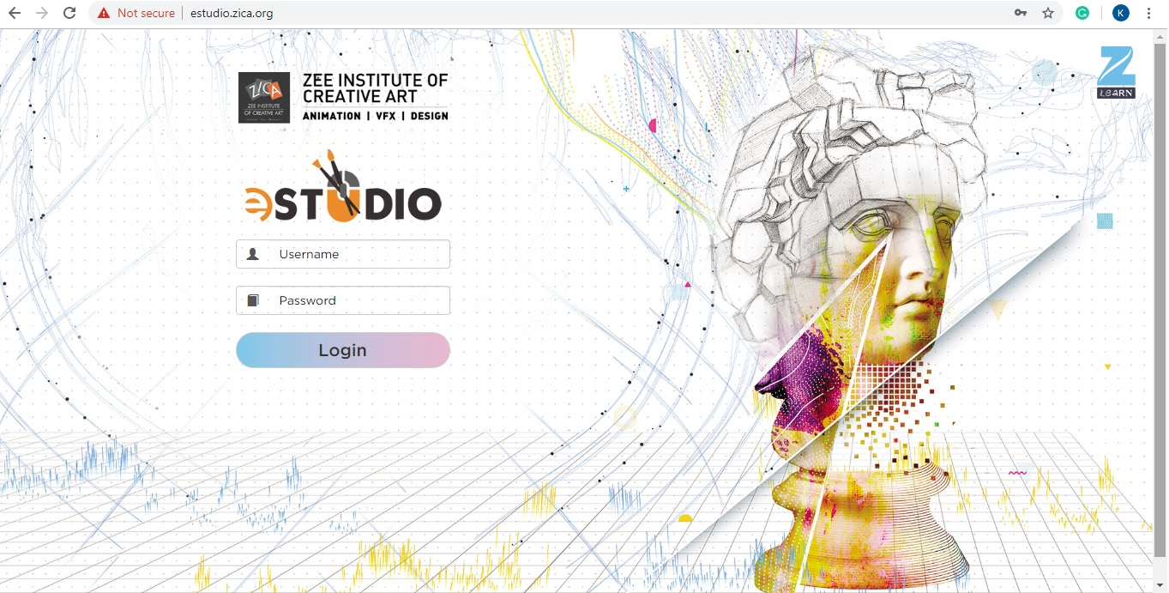
E-STUDIO (ONLINE LEARNING PORTAL)
ESTUDIO will help in enhancing theory knowledge of our students. The portal will contain all reference study material related to the course in which the student has enrolled.
Student can access the portal by clicking on below link: http://estudio.zica.org
The login and password to access the ESTUDIO portal will be the same as which is being used for accessing ZICA MIS.

Slide 100
ONLINE SESSIONS (FACEBOOK LIVE / SKYPE)

Slide 101
ONLINE MASTERCLASS

Slide 102
ONLINE MASTERCLASS
NOIDA
CHANDIGARH
HYDERABAD
INDORE
BORIVALI
RANCHI

Slide 103
WEBINARS BY INDUSTRY EXPERTS

Slide 104
ZICA
2018-2023
TOP GROWTH SECTORS
STUDENT ACTIVITIES

Slide 105
ARTIST OF THE MONTH
Every month, we award certificates to best student artworks in six different categories
Manual Sketching and Painting
Digital Illustration
Digital Painting
Matte Painting
Photography
3D Artwork
VFX Shots
Theme based artwork
You can find the artworks in ZICA Connect Facebook page

Slide 107
AESTHETICS
Aesthetics is Zee Group & Zee Learn’s Animation, VFX and Film Making annual conclave of professionals, students and corporates in the related fields. It gives a common platform to the students where the students participate from all corners of the country, exhibit their creative talent and win awards.
CATEGORIES
2D Animation Visual Effects Live Action film
3D Animation Stopmotion Documentary Films

Slide 108
AESTHETICS

Slide 109
AESTHETICS

Slide 110
AESTHETICS

Slide 111
AESTHETICS - STUDENT FILMS
I WISH
YEH KAISI PUJA
YEH JEEVAN HAI
THE SHINER
ACHING ART
THE CONTRAST

Slide 112
2018-2023
TOP GROWTH SECTORS
ZICA PLACEMENT

Slide 113
CAREER OPPORTUNITIES
Graphic Designer
Storyboard Artist
Character Designer
2D Animator
Background Painter
Stop Motion Animator
Architectural Animator
Product Designer
Texture Artist
Lighting Technician
Character Rigger
Character Animator
Roto Artist
Matchmover
Matte Painter
Pipeline TD
Compositing Artist
Effects Animator
Render Wrangler
Video Game Designer
VFX Producer
CG Supervisor
VFX Supervisor
Compositing Artist
Effects Animator
Render Wrangler
Tracking Artist
Advertising art director
Graphic designer
Illustrator
Printmaker
Exhibition designer
Fine artist
Interior and spatial designer
Landscape architect
Medical illustrator
Multimedia specialist
UX designer

Slide 114
PLACEMENTS IN 2022 – 23 (Few Snapshots)
Lavesh Verma
Company: Digital District
Karan Hirani
Company: Zee Studios
Lakhan Sharma
Company: Digital District
Krati Khandelwal
Company: Redchillies VFX
Abhishek Panwar
Company: Beyond View Studios
Dev Rajore
Company: Rockstar Games
Pratik Bharke
Company: RGBA Studios
Jasobanta Behera
Company: DNEG
Susmita Nayak
Company: Prime Focus
Riya Jain
Company: DNEG Studios
Jagdish Yadav
Company: Famulus Media and Entertainment
Sourabh Makhija
Company: Golden Robot

Slide 115
PLACEMENT POLICY
1. Eligibility Criteria
Course Completion
Quality show-reel/portfolio submitted and assessed by the Technical Team
Complete fees paid
Attendance (minimum 75%)
2. Updating Academic Information in ZICA MIS
Student should update Specialisation, Job Profile, Job Location and Updated CV.
3. Updating Personal details in MIS
Student e-mail ID and the mobile number registered in MIS needs to be checked
4. CV Creation, Verification and Changes, if any:
Create CV as per format shared
Verify CV by Center Head
5. Attendance during the Placement Drive:
It is mandatory to attend the schedule interview
No show will lead to strict action
6. Dress Code and Grooming during the interview:
Girls & Boys - Smart Formals & Shoes
Coordination with Placement Department/ Center Heads:
Centers should always act as intermediaries between the Placement Department and the students
8. Rules to be followed during the Interview Process:
No salary negotiations with the company
No lobbying with HR or company member
No parent interaction with company HR for their ward’s
Avoid Derogatory remarks on colleagues/Institute
No placement assistance will be provided to those who deliberately underperform during the selection processes.

Slide 116
Question and answer

